Slide 1
Chapter 1. Introduction

Slide 2
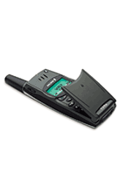

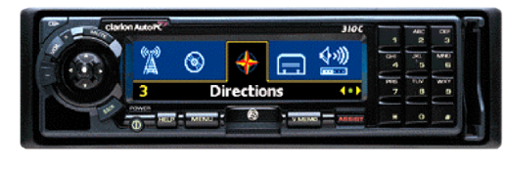
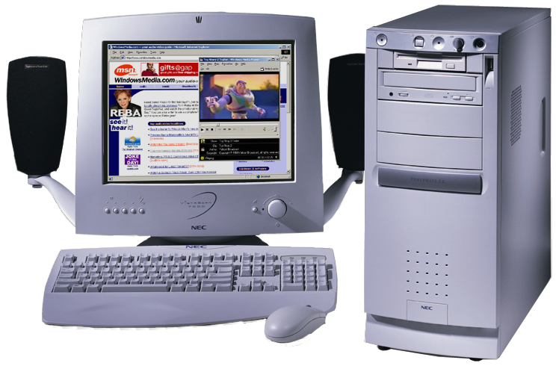
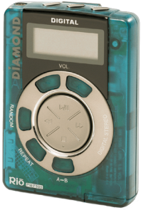
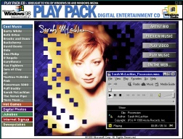
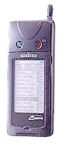
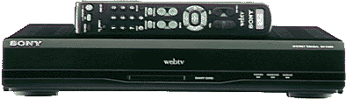
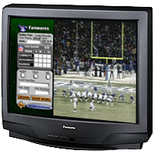
Digital Media World
Many devices
Wired or wireless
Access from anywhere
Software Integration
Personalized delivery
Rich Services

Slide 3
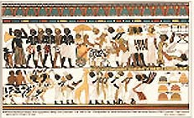
Visual Communication Applications (1/4)
Applications driving the technology
Visual communication needs evident from paintings in ancient caves

Slide 4
Visual Communication Applications (2/4)
Videophone at Home
PC-based videophone at office
Monitoring/
Elder care
Network
Remote collaborations
PC, LAN,
Wireless, POTS,
ISDN, ADSL,
Cable Modem,
…

Slide 5
Visual Communication Applications (3/4)
One-way applications
Video streaming, video on demand, Video broadcasting,
Video email, Video surveillance, Digital TV, HDTV, DVD,
VCD, Digital camera, Digital camcorder, Digital VCR,
Games, …
Limitation: Bandwidth
Two-way applications
Videophone, Videoconferencing, Distance learning,
Remote collaboration, Games, …
Limitations: Bandwidth, End-to-end Delay

Slide 6
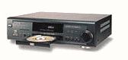
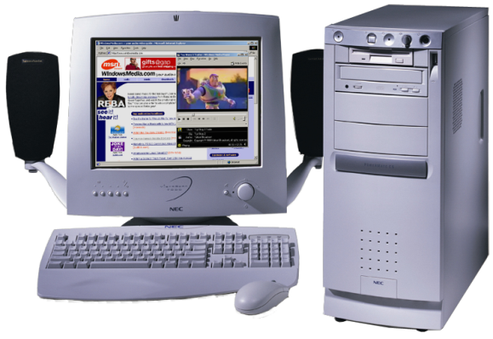

Visual Communication Applications (4/4)
Support many hardware and software products:
Multimedia appliances, streaming server, hardware/software codecs, embedded systems, ASICs, IP, media processors, PC cards, applications software, authoring tools, Indexing and retrieval software systems, …

Slide 7
Overview of Video Coding Techniques

Slide 8
Video Coding Standards
Every standard was developed with an initial driving-application which may be different from the current driving applications
The requirements from the driving-applications determined how the standard was developed
Current driving applications determine how the standards will evolve
The application ultimately determines if the standard will be successful
ITU-T vs. ISO

Slide 9
Some Video Coding Standards
Specify only the decoder(encoder跟著變)
Standardize the minimum

Slide 10
JPEG

Slide 11
JPEG
Driving application: image compression for storage
Technology: Integration of existing techniques
discrete cosine transform (DCT) and entropy coding

Slide 12

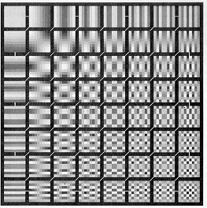
Discrete Cosine Transform (DCT)
8x8 DCT
basis functions
$$X\left(k_{1},k_{2}\right)=α\left(k_{1}\right)α\left(k_{2}\right) \\ \sum_{n_{1}=0}^{N−1}{\sum_{n_{2}=0}^{N−1}{x\left(n_{1},n_{2}\right)\cos\left[\frac{\left(2n_{1}+1\right)k_{1}π}{2N}\right]cos\left[\frac{\left(2n_{2}+1\right)k_{2}π}{2N}\right]}},$$

Slide 13
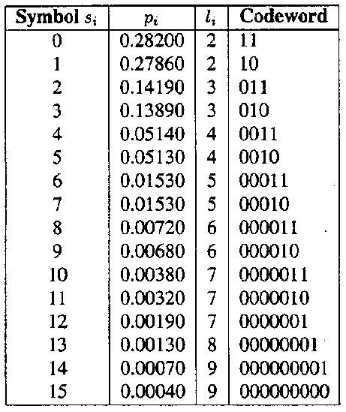
Entropy Coding
Run-length Coding:
Input sequence:
0,0,-3,5,1,0,-2,0,0,0,0,2,
-4,3,-2,0,0,0,1,0,0,-2
Run-length sequence:
(2,-3)(0,5)(0,1)(1,-2)(4,2)
(0,-4)(0,3)(0,-2)(3,1)(2,-2)

Slide 14

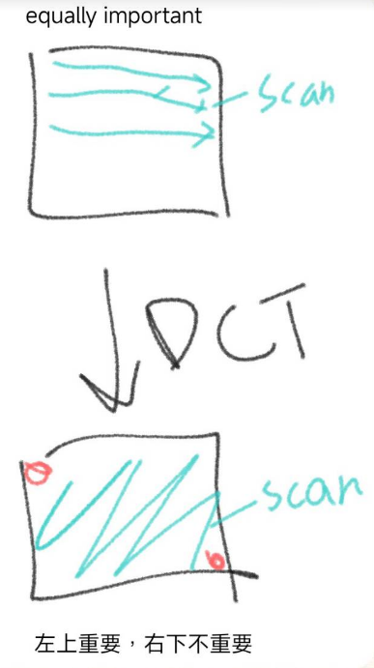

JPEG: DCT + Quantization + Entropy Coding
DCT+ Quantization + Variable-Length Coding
②
Motion compensated
difference block
①
994
-
34
20
38
22
0
5
-
1
DCT
-
49
17
8
-
17
-
4
-
1
4
-
2
149
35
-
37
-
15
1
3
-
1
-
4
58
8
-
32
-
3
-
9
-
11
2
-
4
-
27
5
26
6
9
7
8
0
9
41
53
8
0
1
-
1
2
③
0
2
-
1
-
6
-
2
-
3
0
1
DCT
Q
Z
3
-
14
-
12
2
-
1
-
7
-
5
-
1
①
②
Quantization
(step size = 30)
③
IQ
④
33
-
1
1
1
1
0
0
0
-
2
1
0
-
1
0
0
0
0
IQ, IDCT
5
1
-
1
0
0
0
0
0
2
0
-
1
0
0
0
0
0
IDCT
-
1
0
1
0
0
0
0
0
0
1
2
0
0
0
0
0
0
0
0
0
0
0
0
0
④
0
0
0
0
0
0
0
0
Mean Square Error = 38.75

Slide 15


An Example of JPEG Encoded Image
Original
JPEG Encoded

Slide 16
H.261

Slide 17
H.261
Initial driving application: ISDN videoconferencing
New technology used:
MCPC(Motion compensated predictive coding)
ISDN(integrated service digital network)：整合電話電報等等轉類比成數位的系統
MCPC：只coding frame之間的差異(但是有delay，因為依賴前面的frame)

Slide 18

H.261
JPEG + Motion Compensated Predictive Coding (MCPC)
best matched block
reference frame
current frame
Block-based coding，coding （mvx，mvy）（block移動了多少）+block residue（block內的差異）

Slide 19
Motion Compensation Prediction (MCP)
Encoder
Decoder
current
frame
previous
frame
residuals
MV

Slide 20
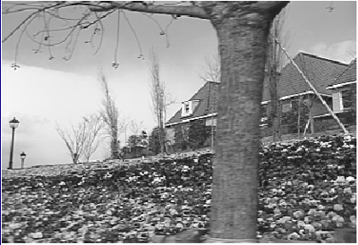
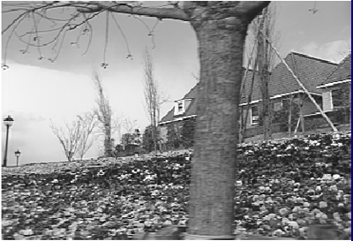
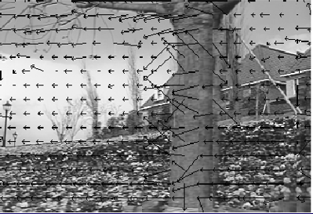
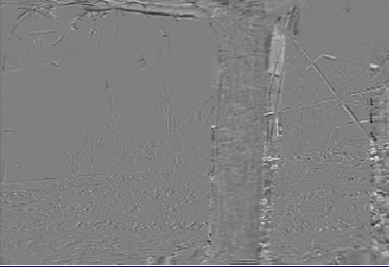
Motion Compensated Predictive Coding
Frame 1
Frame 2
Frame2 with MV
MC prediction error frame

Slide 21
H.261 Video Codec
Video
In
+
DCT
Q
VLC
Buffer
-
IQ
IDCT
+
Motion
Compensated
Prediction
decode時的ref. Frame是用reconstructed ref.，因為經過encode decode 後一定會有誤差，所以不是raw data
VLC: variable-length coding

Slide 22
MPEG-1

Slide 23
MPEG-1
Initial driving application: video CD
New concepts:
bi-directional motion estimation with half-pixel accuracy
Half-pixel為在pixel間再新增對半點，使移動可以為0.5（原為integer），可以讓轉的品質變好

Slide 24
MPEG-1
H.261 + half-pixel bi-directional MCPC
Frame N-1
Frame N
Frame N+1

Slide 25

Group of Pictures
品質來說I > P > B，v.s. H.261這個會誤差越來越大（因為計算ref一直下去），不像這個有一定時間就拿到I，可以不會一直錯下去
I = Intra-picture coding, allow random access, for reference
P = Predictive coding, causal prediction only, can be referenced
B = Bi-directional coding, noncausal prediction, never referenced

Slide 26
MPEG-2

Slide 27
MPEG-2
Initial driving application: video-on-demand over HFC (hybrid fiber coaxial) networks
Main new concepts:
* Frame-field adaptive DCT and motion estimation
* Profiles and levels
* Scalable coding
The most successful video standard for high quality applications (DVD, Digital TV, HDTV, ...)
- Not suitable for low-bit-rate applications, due to the overheads
scalable coding就是在coding時縮小並計算縮小放大後（interpolation）與原圖的差異（residue），進行傳輸

Slide 28
Profiles and Levels
Profiles
Simple
Main
SNR
Scalable
Spatially
Scalable
High
Levels
High
1920x1152
(60 frames/s)
62.7 Ms/s
80 Mbit/s
100 Mbit/s
for 3 layers
High-1440
1440x1152
(60 frames/s)
47 Ms/s
60 Mbit/s
47 Ms/s
60 Mbit/s
for 3 layers
80 Mbit/s
for 3 layers
Main
720x576
(30 frames/s)
10.4 Ms/s
15 Mbit/s
for 2 layers
10.4 Ms/s
15 Mbit/s
10.4 Ms/s
15 Mbit/s
20 Mbit/s
for 3 layers
Low
352x288
(30 frames/s)
3.04 Ms/s
4 Mbit/s
for 2 layers
3.04 Ms/s
4 Mbit/s
* numbers in the table are maximum allowed

Slide 29
Frame/Field Adaptive Coding
16
16
8
Frame format
16
Field format

Slide 30
H.263
Initial driving application: videophone / wireless video
New technologies: 4 optional modes
Suitable for low-bit-rate applications due to the optimized overheads
Current driving applications: internet / wireless video

Slide 31
Four Negotiable Options
Annex D: unrestricted motion vector
Motion vectors can point outside the picture, maximum range for motion vectors: -31,5 to 31.5 instead of -16 to 15.5 (useful in case of higher resolution format and movement along the edge of the picture and camera movement)
Annex F: advanced prediction mode
8x8 motion vectors, overlapped block motion compensation (OBMC), motion vector can point outside the picture
Annex E: syntax-based arithmetic coding
About 5% decrease in bit-rate
Annex G: PB-frame mode
overlapped block motion，可以blocking effect reduction

Slide 32
H.263+ / H.263 Version 2
Annex D: New Unrestricted Motion Vector Mode (use RVLC,
motion vector range up to +/- 256)
Annex I: Advanced Intra Coding Mode
Annex J: Deblocking Filter Mode
Annex L: Supplemental enhancement information specification
Annex M: Improved PB-Frame Mode
Annex O: Temporal, Spatial, and SNR Scalability Mode
Annex P: Reference Picture Resampling Mode
Annex Q: Reduced Resolution Update Mode
Annex S: Alternative Inter VLC Mode
Annex T: Modified Quantization Mode
RVLC（reversible variable-length coding），對其進行順向decode與從SYN 往前逆向decode，如果到某處兩邊都發生出錯，則此處即為錯誤點
在variable-length coding中，若其中的bit變了，就會一直錯下去。解法：新增SYN（synchronization codeword），表示從這邊開始又是新的字，重新開始decode
Error resilience:
Annex K: Slice Structured Mode
Annex R: Independent Segment Decoding Mode
Annex N: Reference Picture Selection Mode

Slide 33
MPEG-4

Slide 34
MPEG-4
Initial driving application:
1. Next generation video coding for very low bit-rate video
2. Object based manipulation
New concepts: object-based coding
Driving application:
MPEG-4 attempts to become the standard for streaming AV media on the Internet and via wireless networks
Error-resilience features, optimized for low-bit-rate applications, fine granular scalability coding
MPEG-4 file format defines first standard for streaming AV media on the Internet

Slide 35
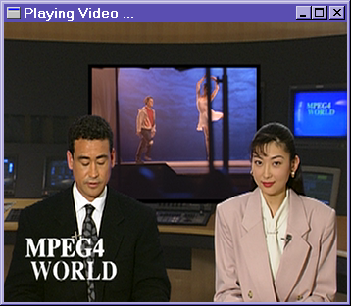
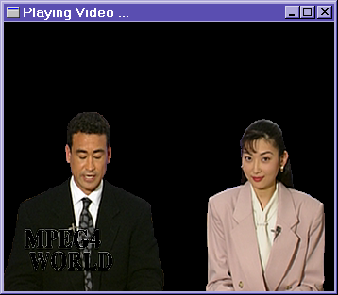
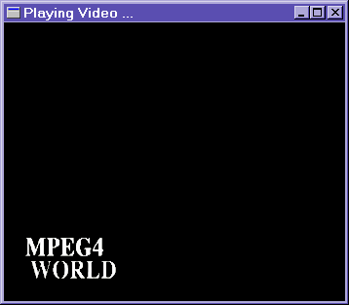
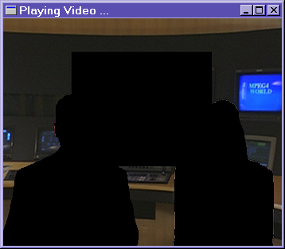
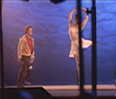
MPEG-4 Video Object Planes (VOP)
VOP1
VOP2
VOP3

Slide 36
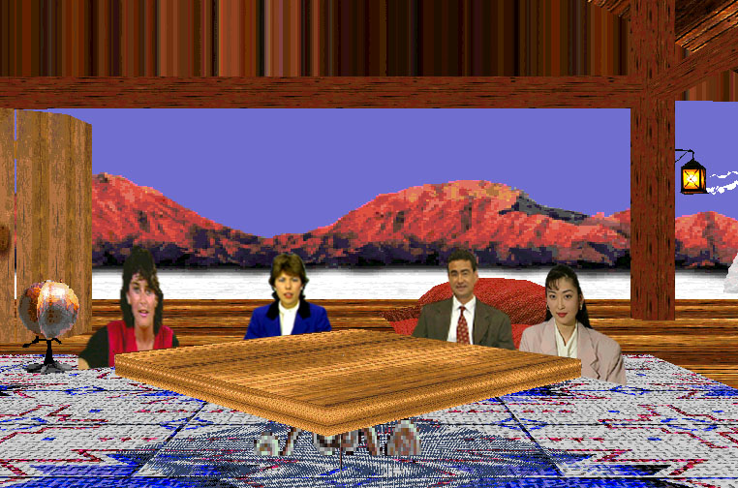
Synthetic and Natural Hybrid Coding (SNHC)

Slide 37
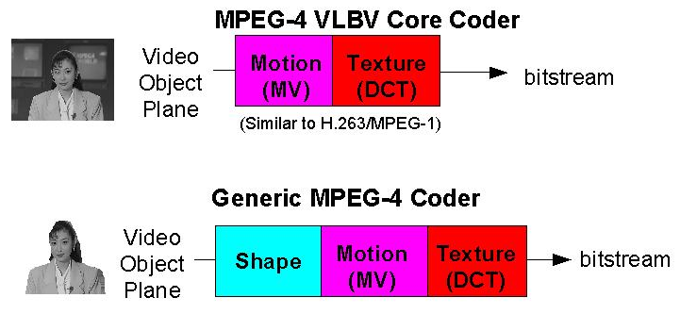
MPEG-4 Texture and Shape Coding

Slide 38
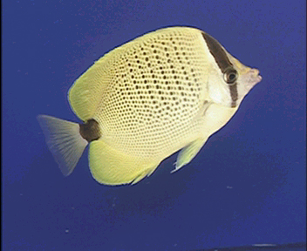
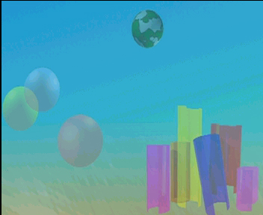



VOP-Based Encoding
content-based
bitstream
scalability
(VOP1)
VOP1
video objects
bitstream
segmentation
(VOP2)
VOP2
& object mask
bitstream
(VOP3)
content-based
VOP3
bitstream access
& manipulation
layered encoding
separate decoding

Slide 39

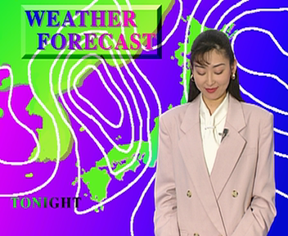
MPEG-4 VOP Decoder
Shape
Decoding
Shape Information
Compositing script
D
E
M
U
L
T
I
P
L
E
X
E
R
Reconstructed
VOP
Motion
Decoding
Motion
Compensation
Video
output
Compositor
Bitstream
Texture
Decoding
VOP
Memory

Slide 40
Sprite Coding
+

Slide 41
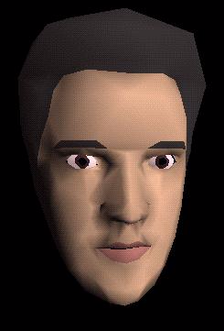
MPEG-4 Visual Face Animation

Slide 42
MPEG-4 ASP (Advanced Simple Profile)
previous techniques + ¼-pixel ME + Global ME
(
x’
1
,y’
1
)
(
x’
0
,y’
0
)
(
x’
3
,y’
3
)
(
x’
2
,y’
2
)
(
x
1
,y
1
)
(
x
0
,y
0
)
(
x
2
,y
2
)
(
x
3
,y
3
)
global motion estimation(ME)：Aflime transform(translation+rotation+scaling)

Slide 43
MPEG-4 FGS (fine granularity scalability)
Shift
Find
Bit-plane
Bitplane
Maximum
VLC
Enhancement
Bitstream
FGS Enhancement Encoding
Input Video
DCT
Q
VLC
Base Layer
Q⁻¹
Bitstream
Motion
Compensation
IDCT
Motion
Frame
MSB0 1000000000000000 …00
MSB1 0010000000000000 …00
MSB2 1010010110010000 …00
MSB3 0000010000000010 …00
Estimation
Memory
Clipping

Slide 44
JPEG-2000

Slide 45
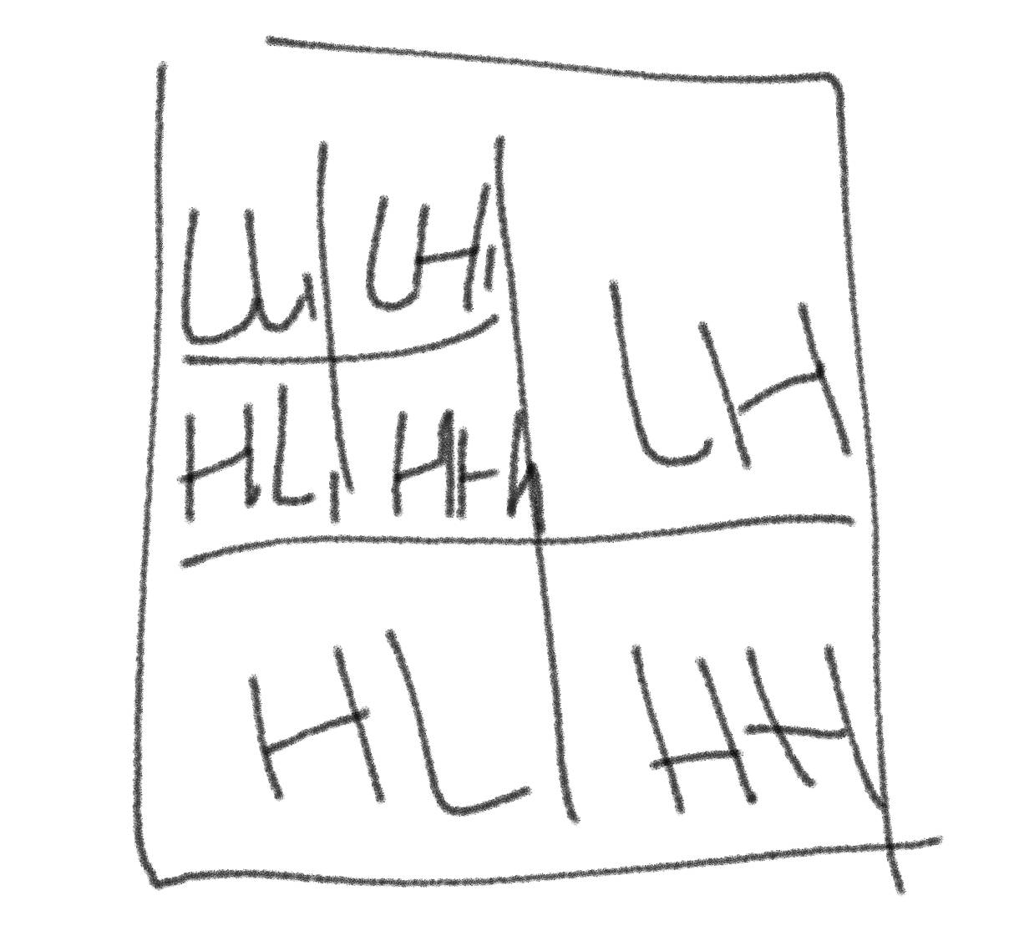
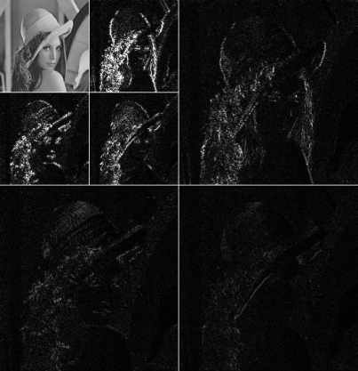
The JPEG-2000 Architecture
JPEG-2000: discrete wavelet transform (DWT) + embedded block coding with optimum truncation (EBCOT)
Input
DWT
Quantizor
EBCOT
與jpeg的DCT(block-based)不同，透過整張進行low/high pass filter，因為大部分都是低頻，所以資訊都留在左上，越右下越沒東西。但是這樣計算下來jpeg所需的計算/memory較小，所以還是比較好用
Storage
or
Channel
Inverse
DWT
Inverse
Quantizor
Inverse
EBCOT
Output

Slide 46
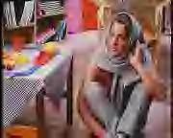
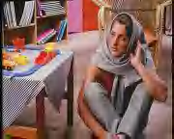


Quality Scalability with JPEG-2000
Improve decoding quality as receiving more bits
32:1
16:1
8:1
4:1
Compression Ratio

Slide 47
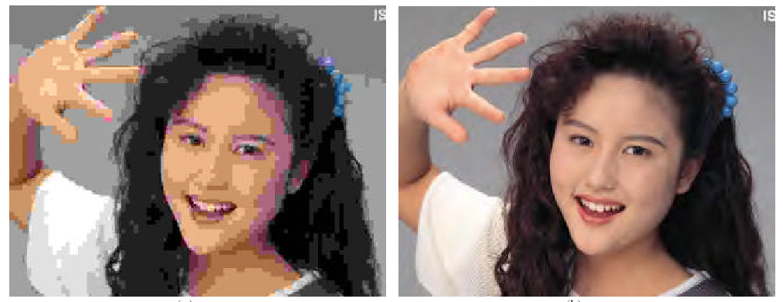
JPEG-2000 vs. JPEG (1/3)
0.125bpp, JPEG
0.125bpp, JPEG-2000

Slide 48
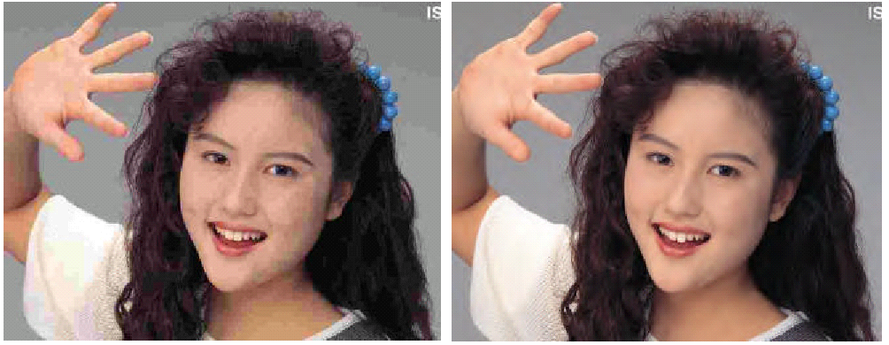
JPEG-2000 vs. JPEG (2/3)
0.25bpp, JPEG
0.25bpp, JPEG-2000

Slide 49
JPEG-2000 vs. JPEG (3/3)
11%
18%
36%
53%
6 observers
6 color images
300 dpi

Slide 50
MPEG-7: Multimedia Content Description Interface
To define standardized solutions that allow users or
agents to search, browse, filter audiovisual content.
query
(MPEG-7)
Search Engine
Image Database
human
in the
loop
input
visualization of result images
user feedback
user categories
User

Slide 51
MPEG-7: Description of Multimedia Information
How can “non-text-information” be described in a useful
way?
Speech- and Audio-Descriptors
Pitch
Melody
Frequency
Sex of speaker
Text
Visual Clues
Texture
Color
Form and Shape (2D/3D)
Motion Activity
Higher Order Object-Models
Persons, Gestures

Slide 52
What MPEG-7 Standardize?
Flexible description
of description schemes
or descriptors
- XML Schema
Description Definition
Language (DDL)
Relations between
descriptors
- shape + motion
- shape + frame no
Description Schemes
Descriptors
- Text,
- Color, Texture
- Shape, Motion
- Pitch, Melody

Slide 53
MPEG-4 AVC/H.264

Slide 54
MPEG-4 AVC/H.264: Features
Motion compensated DCT-like transform
I, P, B, SP, SI
Multiple reference frames
Variable block size – 7 block patterns: 16x16, 16x8, 8x16, 8x8, 8x4, 4x8, 4x4
Up to 16MVs per MB
4x4 integer DCT like transform
Improved intra prediction
Deblocking filter
Interlace coding tools
Universal VLC
Arithmetic coding (CABAC)
1/4 pel interpolation

Slide 55
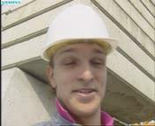
MPEG-4 AVC/H.264: Encoder Architecture
Input
Video
Signal
Split into
Macroblocks
16x16 pixels
Coder
Control
Control
Data
Transform/ Scal./Quant.
Quant. Transf. coeffs
-
Decoder
Scaling & Inv. Transform
Entropy
Coding
De-blocking
Filter
Intra-frame
Prediction
Output
Video
Signal
Motion-
Compensation
Intra/Inter
Motion
Data
Motion
Estimation

Slide 56
MPEG-4 AVC/H.264: Motion Compensation
Input
Video
Signal
Split into
Macroblocks
16x16 pixels
Coder
Control
Control
Data
Transform/ Scal./Quant.
Quant. Transf. coeffs
-
Decoder
Scaling & Inv. Transform
Entropy
Coding
De-blocking
Filter
Intra-frame
Prediction
16x16
16x8
8x16
8x8
MB
0
0
1
Types
0
Output
Video
Signal
0
1
2
3
1
Motion-
Compensation
Intra/Inter
8x8
8x4
4x8
4x4
8x8
0
0
1
Types
0
Motion
Data
0
1
1
2
3
Motion
Estimation
Motion vector accuracy 1/4 (6-tap filter)

Slide 57
MPEG-4 AVC/H.264: Intra Prediction
Input
Video
Signal
Split into
Macroblocks
16x16 pixels
Coder
Control
Directional spatial prediction
(9 types for luma(亮度，對應Y), 1 chroma(顏色，對應Cb、Cr))
e.g., Mode 3: diagonal down/right prediction a, f, k, p are predicted by (A + 2Q + I + 2) >> 2
Control
Data
Transform/ Scal./Quant.
Q A B C D E F G H
I a b c d
J e f g h
K i j k l
L m n o p
M
N
O
P
-
Quant. Transf. coeffs
Decoder
Scaling & Inv. Transform
Entropy
Coding
0
De-blocking
Filter
7
Intra-frame
Prediction
2
8
Output
Video
Signal
4
3
Motion-
Compensation
6
1
5
Intra/Inter
Motion
Data
Motion
Estimation

Slide 58
MPEG-4 AVC/H.264: Transform Coding
Input
Video
Signal
Split into
Macroblocks
16x16 pixels
Coder
Control
Control
Data
Transform/ Scal./Quant.
Quant. Transf. coeffs
-
4x4 Block Integer Transform
Main Profile: adaptive block size transform (8x4,4x8,8x8)
Repeated transform of DC coeffs for 8x8 chroma and 16x16 Intra luma blocks
Decoder
Scaling & Inv. Transform
Entropy
Coding
De-blocking
Filter
Intra-frame
Prediction
Output
Video
Signal
Motion-
Compensation
Intra/Inter
Motion
Data
Motion
Estimation

Slide 59
MPEG-4 AVC/H.264: Multiple Reference Frames
Coder
Control
Control
Data
Transform/ Quantizer
Quant. Transf. coeffs
-
Decoder
Deq./Inv. Transform
Entropy
Coding
0
Motion-
Compensated
Predictor
Intra/Inter
Multiple Reference Frames for
Motion Compensation
Motion
Data
Motion
Estimator

Slide 60
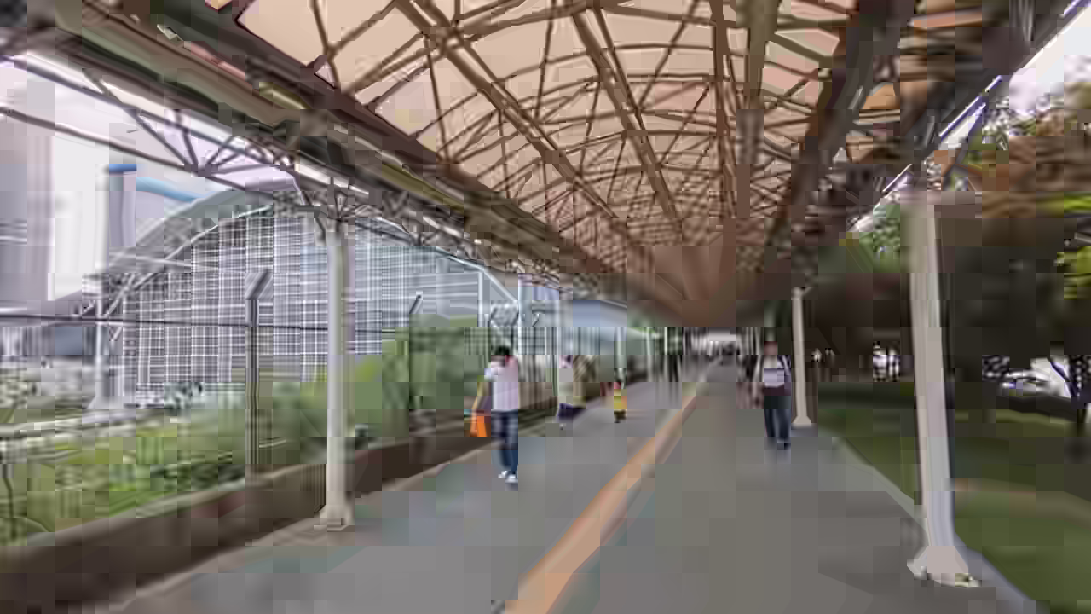
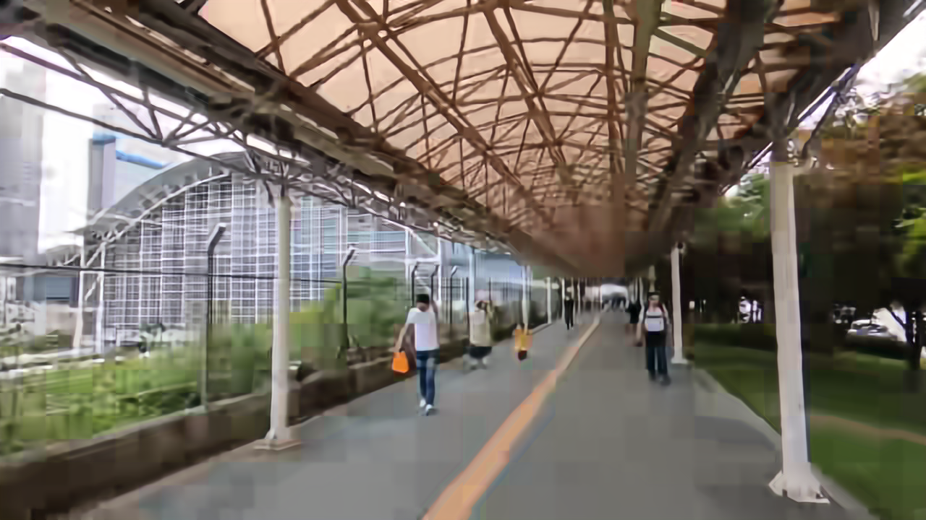
MPEG-4 AVC/H.264: Deblocking Filter
Deblocking filter: highly compressed decoded inter picture
1) without filter 2) with H264/AVC deblocking

Slide 61
Coding Efficiency Comparison (1/4)
PSNR
[dB]
TMN-10
Variable
block size
motion
compensation
(H.263 1998)
Half-pel
motion
compensation
(MPEG-1 1993)
Frame
difference
coding
(H.120 1988)
Foreman
10 Hz, QCIF
100 frames encoded
38
36
?
67 %
34
Intraframe
DCT coding
(DCT 1974,
JPEG 1992)
32
30
Integer-pel
motion
compensation
(H.261 1991)
28
26
bit-rate [kbps]
0
100
200
300
400
500

Slide 62
Coding Efficiency Comparison (2/4)
Foreman QCIF 10Hz
39
38
37
36
35
JVT/H.264/AVC
34
MPEG-4
Y-PSNR [dB]
33
MPEG-2
32
H.263
31
30
29
28
27
0
50
100
150
200
250
bit-rate [kbit/s]

Slide 63
Coding Efficiency Comparison (3/4)
Alias 24 fps SDTV
50
45
40
Y PSNR [dB]
MPEG-2(QP 2-7)
AVC (QP 10,18,26)
35
30
25
0.00
0.50
1.00
1.50
2.00
2.50
3.00
3.50
4.00
4.50
5.00
Mbit/sec

Slide 64
Coding Efficiency Comparison (4/4)
1st
MPEG-2 Encoder
2nd Generation Encoder
3rd Generation Encoder
4th Generation Encoder
5th Generation Encoder
H.264 /
MPEG-4 part 10
Source: Modulus Video

Slide 65
How were the improvements obtained
It mainly comes from incremental improvements:
- Better prediction
- More computation
- More memory
No fundamental changes in the basic algorithm
(DCT + MCPC)

Slide 66
What Else Besides Compression? (1/2)
Networking (wired and wireless):
Scalable coding, Multiple description coding,
Transcoding, Statistical multiplexing, Error-
resilience coding, Error-concealment, Pre/post
processing, Dynamic rate-control, Content-aware
delivery, Joint source channel coding, Peer-to-
peer streaming, Wireless games, …

Slide 67
What Else Besides Compression? (2/2)
Asynchronous applications may see more early success: needs authoring, retrieval, and content filtering tools
Security: advanced video surveillance, face recognition, …
Content protection: IP Protection, encryption, watermarking, …
Implementation: for low-cost low-power high-performance devices, media processors

